Slide 1


Blue Ridge Animal Rescue & Sanctuary
The right side

Slide 2

Table of Contents
Introduction
  Business Process Models
Cost-Benefit Analysis
Product Features & Requirements
  Website Architecture
  Systems, Tools & Services Used
Entity Relationship Diagram
Prototype
Navigation Diagram
Limitations & Future Work
Conclusion

Slide 3
Introduction
Client
  Blue Ridge Animal Rescue and Sanctuary
    Kim Dehler
Blue Ridge Animal Rescue and Sanctuary is a charity helping mistreated and unwanted animals.
  Works with other organizations, individuals, volunteers, etc.
  Communication with the public, key to connecting with the outside

Slide 4

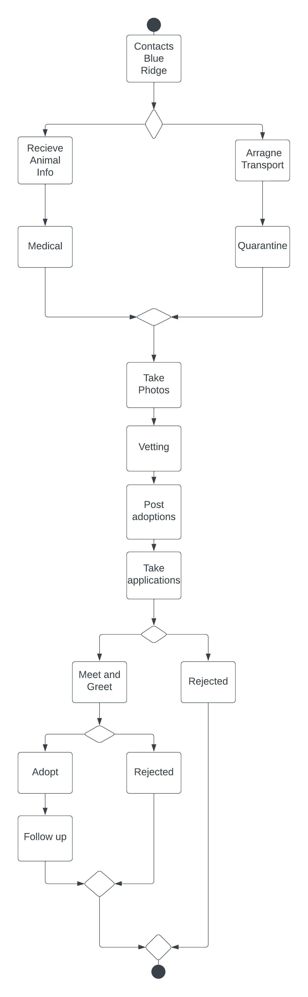


Business Process Model: As-Is

Slide 5
Business Need
What is our problem?
  lacking a website
  Donations
  Communications
  Where business functions can be congregated in one place
What are we trying to achieve with the website?
How are we going to achieve it?

Slide 6
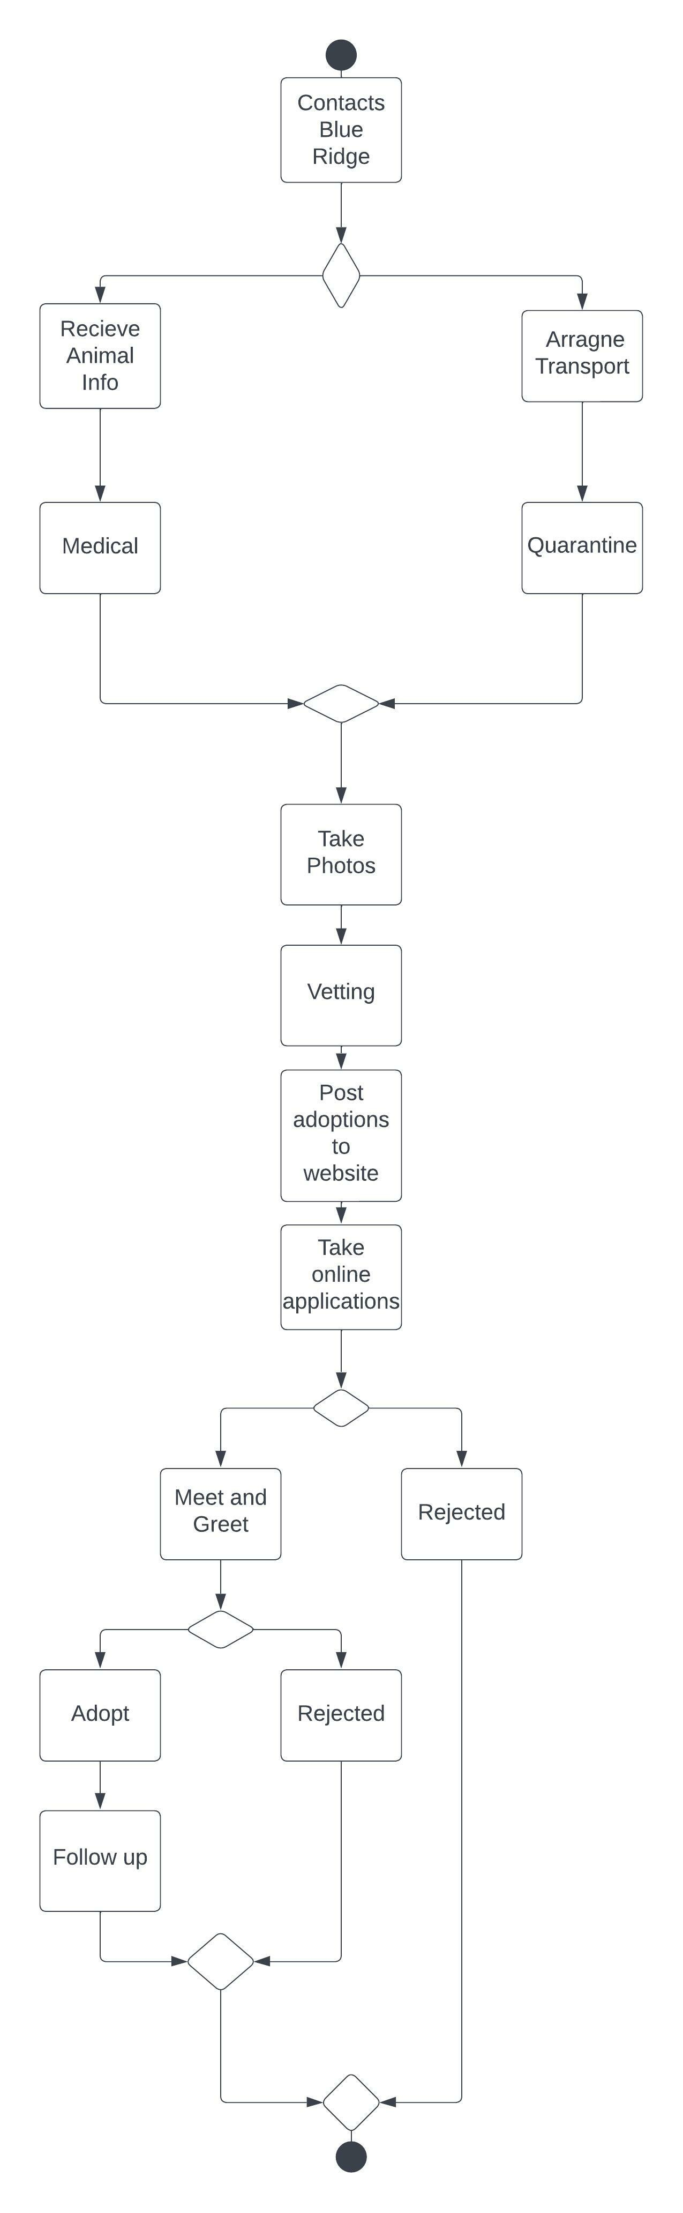
Business Process Model: To-Be

Slide 7
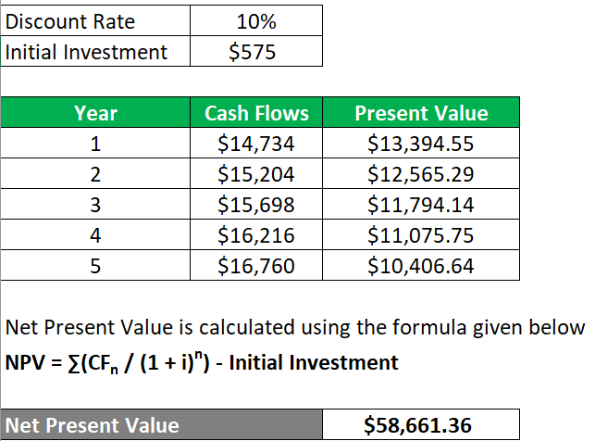
Cost Benefit Analysis
$18-20 per month
NPV
Costs
ShelterLuv: $2 per adoption, billed monthly
WordPress Hosting: $2.95 per month
DonorBox: 1.5% platform fee + payment processing fee
PayPal: 3.49% transaction fee + $0.49 (If Necessary)
Benefits
Approx. Monthly Benefits --> $941
Approx. Adoption Fee --> $300
Approx. 8 adoptions per month

Slide 8
Product Features & Requirements
User friendly & professional web environment
Donation System
  Accepts most major payment forms and secure
Communication system
  Contact forms, newsletters, events calendar
Volunteer Applications
Direct linking to social media
Online adoption forms
Adoption info linked to database
Merchandise store (optional)

Slide 9
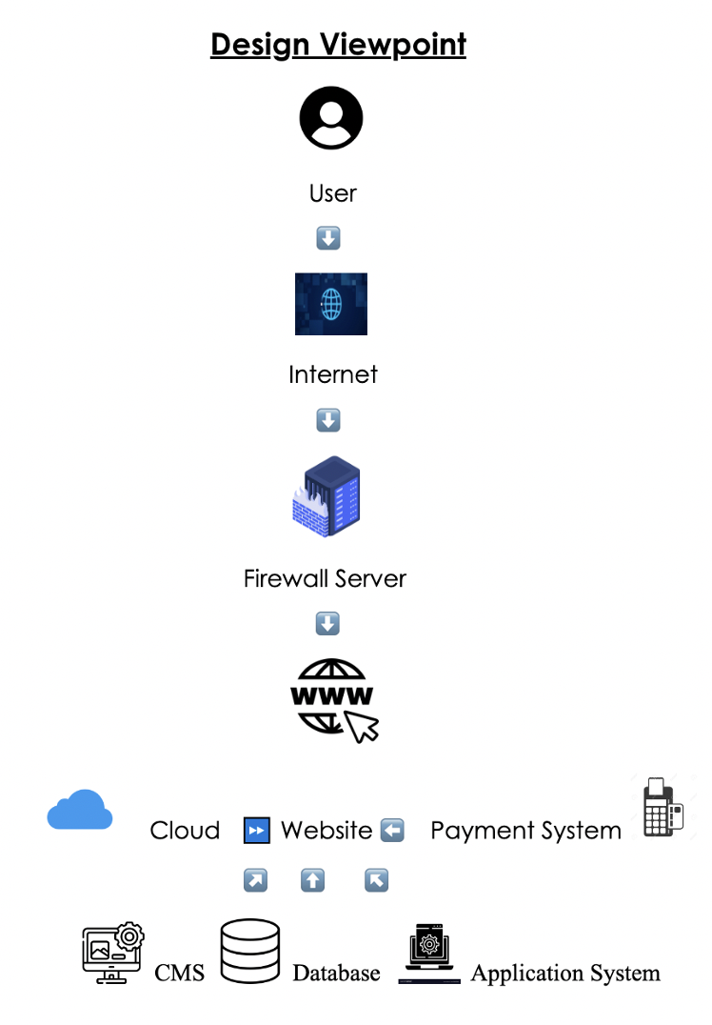
Website Architecture
Notes:
Based on Kim's comments, we changed the database to ShelterLuv

Slide 10
Systems, Tools & Services Used
Website: WordPress
Payment System: Paypal (or other alternatives)
Donation System: DonorBox (or ShelterLuv)
Database: ShelterLuv
Application System: Glassfish
Mailing tool: Sendinblue - WordPress plugin
Events: Event Calendar Plugin - WordPress plugin
Notes:
GlassFish = Java

Slide 11
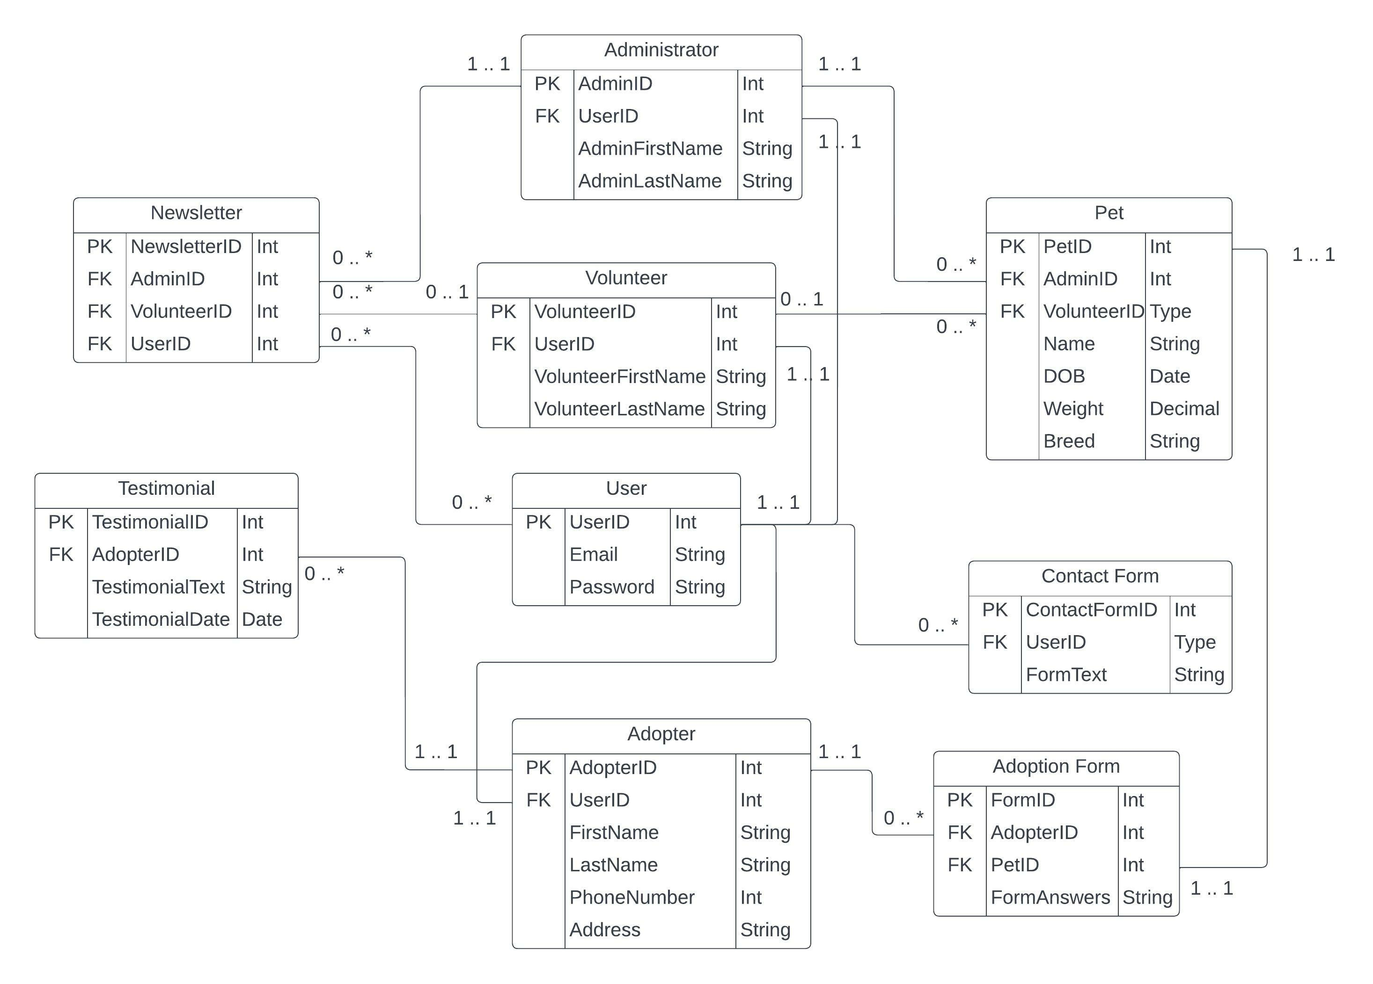
ERD

Slide 12
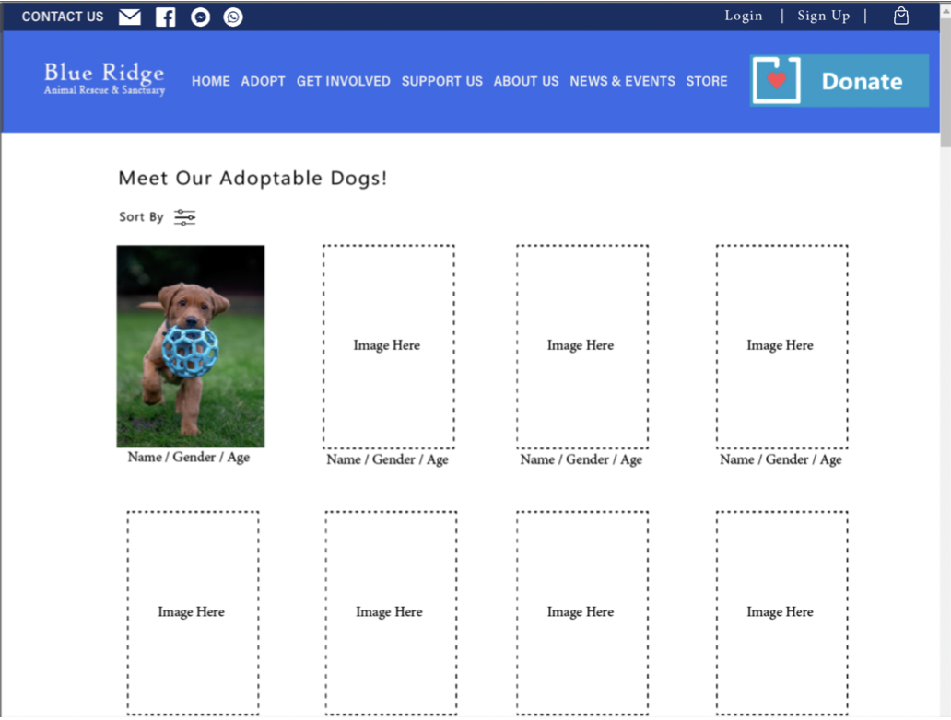
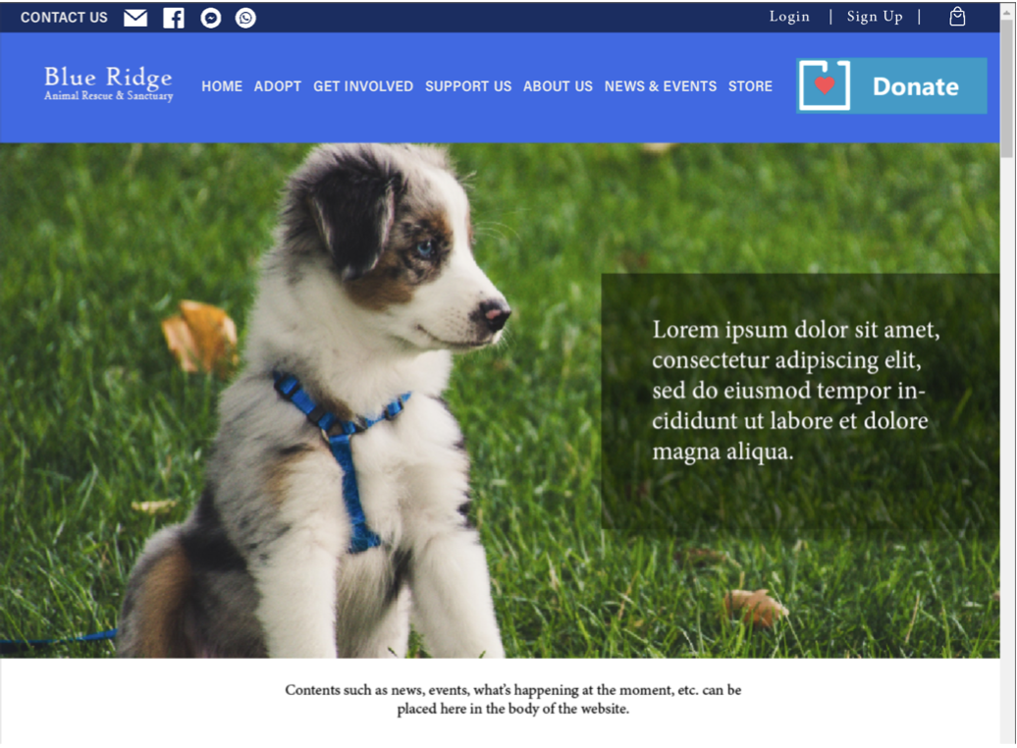
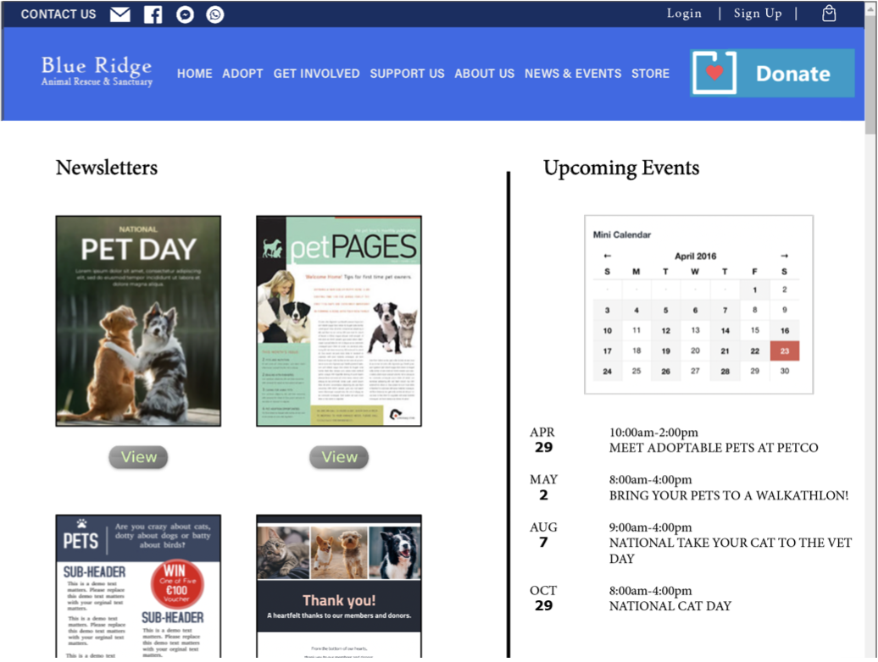
Prototype - Website

Slide 13
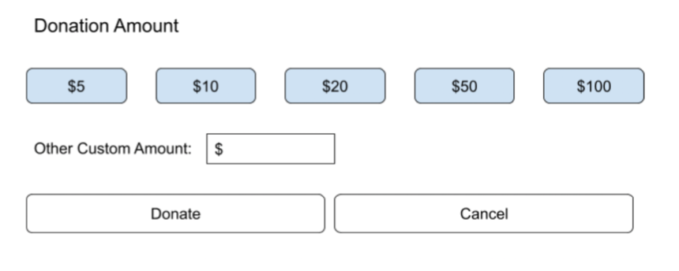
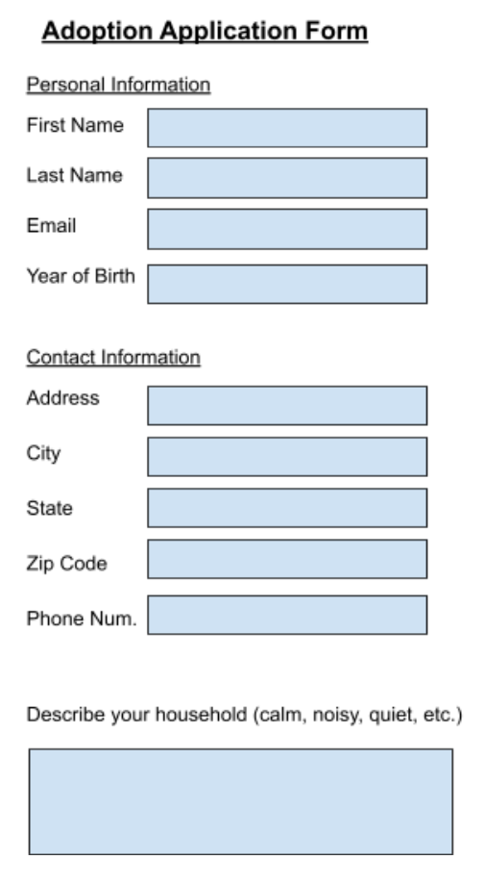
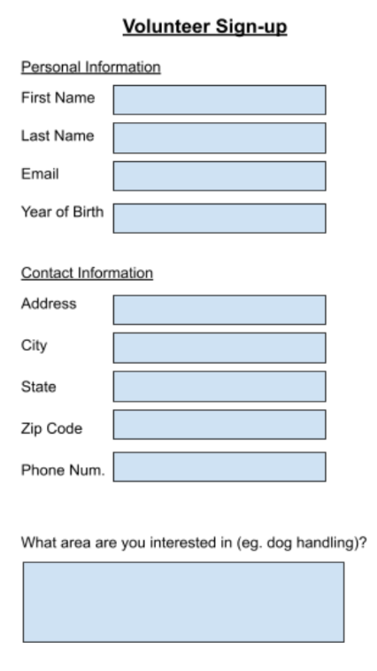
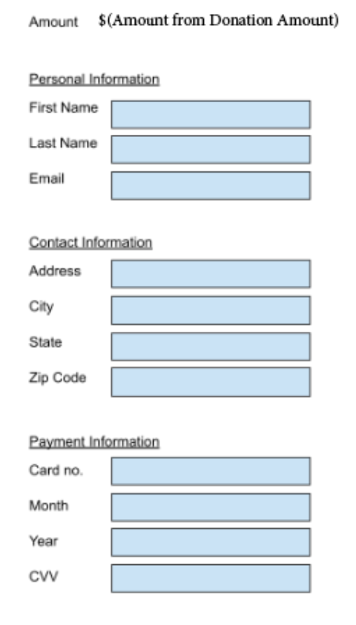
Prototype - Forms

Slide 14
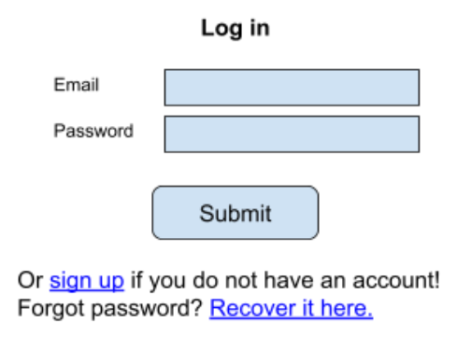
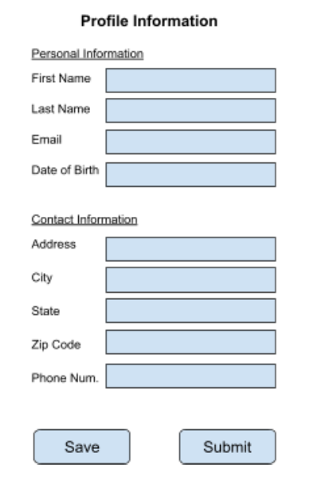
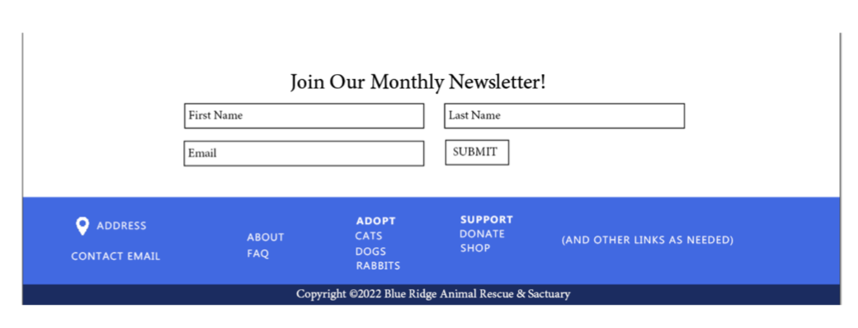
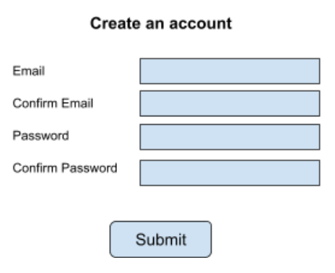
Prototype - Forms

Slide 15
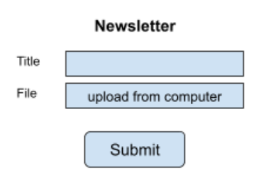
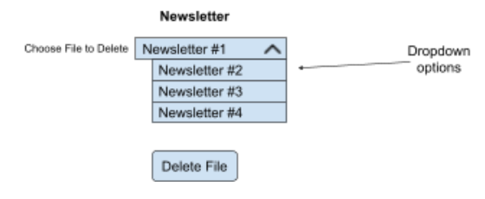
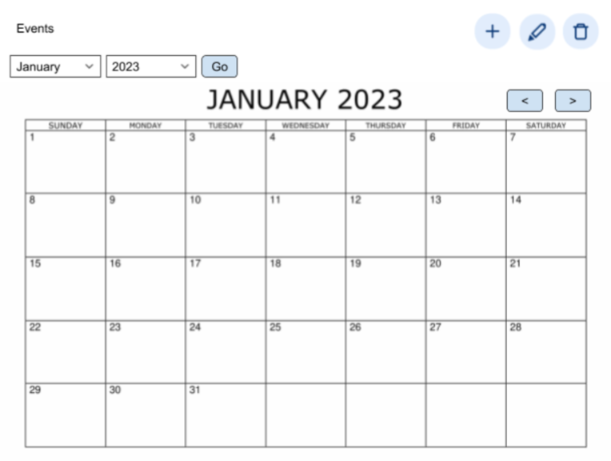
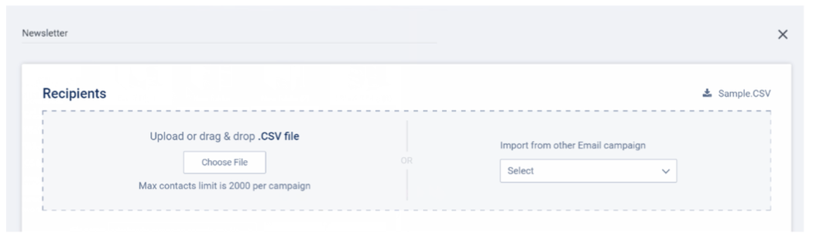
Prototype – News & Events

Slide 16
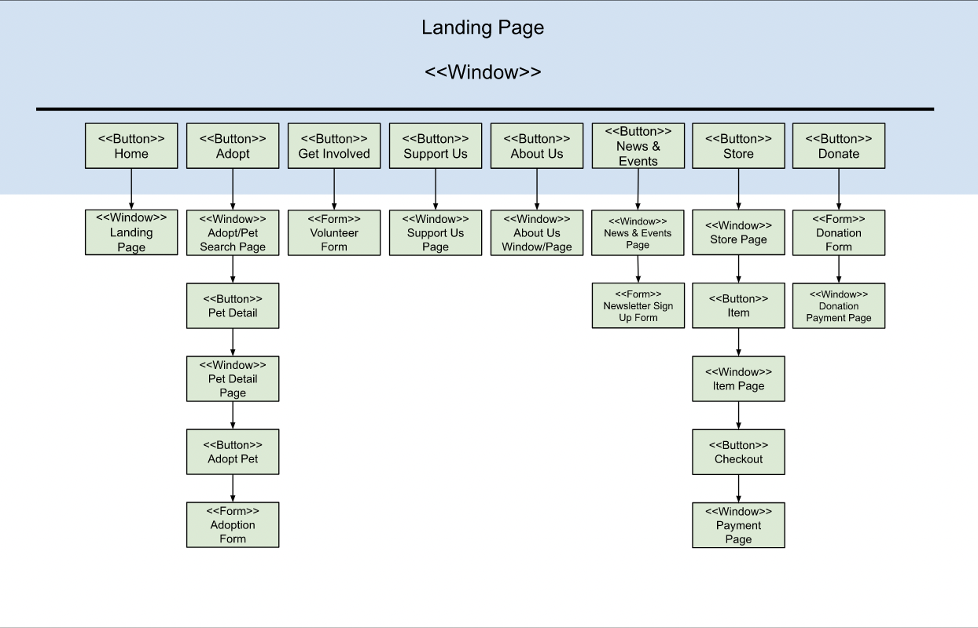
User Interface Navigation Diagram

Slide 17
Limitations & Concerns
Website security
  Unauthorized log-in on admin accounts.
  Information leaks.
  Unsecure plugins.
Constant updates
  Outdated plugins and themes = security risk.
  Must constantly be updated.
Spam Emails
  From unknown people/bots auto-filling forms.
  Risk of phishing.
Content theft
  Images being stolen and being claimed by others.
Training necessary

Slide 18
Future Work
Navigation Bar
Page Layouts
Notes:
(it's not that we don’t have an organized nav bar, just that there may be a way to organize it better. Requires actual testing.)
A lot of the stuff just seems way too cramped.
Same for page layouts

Slide 19
Conclusion
Bring in approx. $941 per month in benefits
$18-20 per month to operate the website
  Low fees
  Cost-friendly
Opportunity for Additional Income
  Merchandise Store
Easy to Navigate/Pleasing to the Eye
  WordPress
  Organization
  Design

Slide 20

Any Questions?

